Slide 1

HDB Resale Prices An Analysis

Slide 2
Who cares?
All Singapore Citizens (SGCs) and Singapore Permanent Residents (SPRs). Anyone interested and eligible to purchase Singapore HDB Resale Flats*
First-time homeowners, family-based units wanting to start families, anyone wanting their own chill-space.
* Resale flats are HDB flats that are currently or had been owned by someone else. That is, they are defined as not new.

Slide 3
Parameters
Analysis time-frame 2009 – onwards.
Emphasis on social factors, effects, and concerns rather than financial or investment considerations.
FYI, and Education- oriented approach preferred at this stage.
Focus Group: birthyears from 1995 to 2010. ALB 25 to 41 years of age
Gen-Y identified as most fluid age-group in terms of major life and lifestyle changes.

Slide 4
HBD Resale flats: The Pros
Resale Applications do not have long waiting times. Immediate purchases occupancy possible because are private transactions between seller and buyer. Flats already built.
Less strict on Eligibility criteria: 2 SPRs vs. minimum 1 SGC.
Greatest freedom and flexibilities on flat sizes and locations and sizes.
No income ceiling limits.

Slide 5
The Cons…
Must fall under umbrella of various family-connected schemes and age restrictions:
Age 21 and 35 milestones
Public / Engaged / Singles / Non-Citizen Spouse Schemes* *not comprehensive
Fewer HDB subsidies and less housing loan schemes options.
Need Substantial Cash monies and reserves on hand.

Slide 6
The Cons, continued…
Being open-market transactions greater flexibility also means greater risks. Issues like COV, market trends and volatility, sudden changes in government regulations like extra duties and taxes, loan limit restrictions, etc.
Restrictions on multiple ownership of properties: Applicants cannot concurrently own more than 1 resale flat and/or private property, either locally or overseas, beyond 6 months after date of purchase.

Slide 7
Dates to Note
2007, mid – Start of the global financial crises.
2009, – Resale Price Index was reset to 100% baseline.
2012, Mar – Change in of data reporting nomenclature
2017, Mar – MND posts that SERS not universal for all HBD flats
2020, Feb – Start of Covid-19 pandemic and multi-faceted crises.
2021, Jul & onwards – The global Covid-19 crises continues to evolve and change
* The global financial crises. refers to the period of extreme stress in global financial markets and banking system between mid-2007 and early 2009
** Note: Post March 2012: data was based on registration rather than approval dates for resale transactions.'

Slide 8
HDB Resale Prices (start 3rd Quarter 2021)
Prices rose 2.8 percent in @2nd Quarter 2021.
RPI rose from142.2 to 146.2. 12th straight month of increase
Central areas – e.g., Tjpg, Queenstown, Bishan; and
Serangoon and Woodlands saw biggest increases.

Slide 9
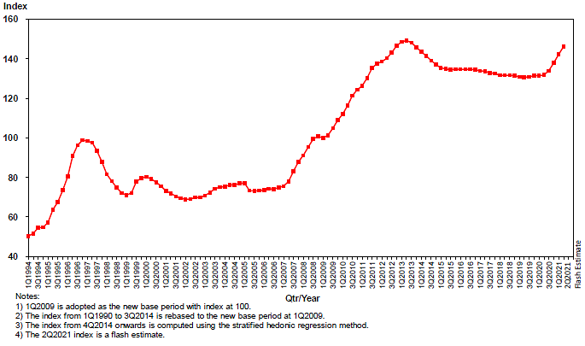
Resale Prices Index 1994 -2021

Slide 10
Resale Price RSI (previous 12mths)

Slide 11
Overall Resale Volume (Jun 20 –Jun 21)

Slide 12
RSI by Flat Types

Slide 13
Median Resale Prices

Slide 14
Supply Shortages in the New
Delays in new Build-to-Order flats projects:
Construction delays due to manpower shortages, domitories quarantine, circuit breaker, tightened foreign manpower guidelines, recent Phase 2 (HA). Delays of about a year on most new Projects.
Disruptions in global labour movements and commodity supply chains due to Covid spreads and lockdowns.
short

Slide 15
Greater Demand for the Old
Demand fueled by buyers downsizing from private properties.
Demand uneven across flat locations and types. Steeper demand for larger units
More buyers willing to match the valuation of properties and more, particularly popular locations. More COV situations seen. Million-dollar flats phenomenon.

Slide 16
The RSI & This Little Red Dot . . .1
Bullish numbers see industry watchers predicting an overall 8-11% increase in the RPI for 2021.
COV numbers and amounts will continue an upward trend. Figures of flats sold from Jan 2020 till the last reporting in April this year, showed 25% were sold with COV.

Slide 17
The RSI & this Little Red Dot . . .2
Dual pull-and-push demand and supply economic variants will keep prices elevated. Emergence of the Delta Variant and developments in the Indian sub-continent -Labour. Covid situation in Indonesia commodities and raw materials.
Possible various effects (butterfly, domino, cascading) on SG

Slide 18
Everywhere Else … 1
Global pandemic measures to tackle Covid will be piecemeal with region-based but no comprehensive global efforts.
Lack of global information sharing in many areas will hamper Covid responses.
Geopolitical uncertainties and tensions among Great Powers, like US, China and Russia.

Slide 19
Everywhere Else . . . 2
Flashpoint areas: South China Sea, Taiwan Straits, Korean Peninsula
Iran and nuclear proliferation, Israel-Palestine issues.
Continuing uncertainties over multi-faceted crises.

Slide 20
Postscript
2021, July – Singapore indicates Covid to stay as an epidemic condition.
Living with Covid long-term.
What does this mean re the Project topic?
What does it mean for humankind and domestic pets?
Coming to somewhere near you - Covid-29 or Covid-39?

Slide 21
Skills Gap
Technical skills
Data visualization

Slide 22
